Slide 1

Applied Data Science Capstone
Wojciech Bahonko
30-June-2024

Slide 2



OUTLINE
Executive Summary
Introduction
Methodology
Results
Conclusion
Appendix

Slide 3
EXECUTIVE SUMMARY
In this capstone, we will predict if the Falcon 9 first stage will land successfully using couple of methodologies below
Main methodologies
Data Collection thru API and using Web Scraping
Data Wrangling
Exploratory Data Analysis with SQL and with Data Visualization
Interactive Visual Analytics with Folium and with Ploty Dash
Machine Learning Prediction
In the presentation presents the following results
Exploratory Data Analysis results
Interactive analytics demo in screenshots
Predictive Analytics results

Slide 4
INTRODUCTION Background and Context
The commercial space age is here, companiesare making space travel affordable for everyone.
Perhaps the most successful is SpaceX.
One reason SpaceX can do this is the rocket launches are relatively inexpensive.
SpaceX advertises Falcon 9 rocket launches on its website, with a cost of 62 million dollars;
other providers cost upward of 165 million dollars each, much of the savings is because SpaceX can reuse the first stage.
Therefore if we can determine if the first stage will land, we can determine the cost of a launch and also determine if SpaceX will reusethe first stage.
This information can be used if an alternate company wants to bid against SpaceX for a rocket launch

Slide 5
INTRODUCTION Main Question
that we are trying to answer is, for a given set of features about a Falcon 9 rocket launch which include its payload mass, orbit type, launch site etc. will the first stage of the rocket land successfully?

Slide 6
METHODOLOGY
Data Collection using SpaceX API
Data Collection using Web Scraping from Wikipedia
Data Wrangling
Exploratory Data Analysis (EDA) with SQL
Exploratory Data Analysis (EDA) with Visualization
Interactive Visual Analytics with Folium
Interactive Dashboard with Ploty Dash
Predictive Analysis – using Machine Learning models.

Slide 7
METHODOLOGY Data Collection with API
Main Steps performing data collection using SpaceX API:
start requesting rocket launch data from SpaceX API
decode the response content as a Json using .json() and turn it into a Pandas dataframe using .json_normalize()
use the API again to get information about the launches using the IDs given for each launch.
construct our dataset using the data we have obtained and combine the columns into a dictionary
create a Pandas data frame from the dictionary.
filter the dataframe to only include `Falcon 9` launches.
deal with missing Values
save results to .csv file
GitHub URL of Jupyter notebook: SpacexDataCollectionAPI

Slide 8
METHODOLOGY Data Collection Web Scraping
Main Steps of performing web scraping with BeautifulSoup to collect Falcon 9 historical launch records from a Wikipedia page
request the Falcon9 Launch Wiki page from its URL
create a `BeautifulSoup` object from the HTML `response`
extract all column/variable names from the HTML table header
create an empty dictionary with keys from the extracted column names
parsing launch of HTML tables
create dataframe from dictrionary
export results to .csv file
GitHub URL of Jupyter notebook: WebScraping

Slide 9
METHODOLOGY Data Wrangling
Main Steps of Data Wrangling
calculate the number of launches on each site
each launch aims to an dedicated orbit, and here are some common orbit types
calculate the number and occurrence of each orbit
calculate the number and occurence of mission outcome of the orbits
create a landing outcome label from Outcome column
Export results to .csv file
GitHub URL of Jupyter notebook: DataWrangling

Slide 10
METHODOLOGY EDA with SQL
Performed the following SQL queries
display the names of the unique launch sites in the space mission.
display five records where launch sites begin with the string 'CCA’
display the total payload mass carried by boosters launched by NASA (CRS)
display average payload mass carried by booster version F9 v1.1
list the date when the first succesful landing outcome in ground pad was acheived.
list the names of the boosters which have success in drone ship and have payload mass greater than 4000 but less than 6000
list the total number of successful and failure mission outcomes
list the names of the booster_versions which have carried the maximum payload mass.
list the records which will display the month names, failure landing_outcomes in drone ship ,booster versions, launch_site for the months in year 2015
rank the count of landing outcomes (such as Failure (drone ship) or Success (ground pad)) between the date 2010-06-04 and 2017-03-20.
GitHub URL of Jupyter notebook: ExploratoryDataAnlysisSQL

Slide 11
METHODOLOGY EDA with Visualization
Using data from API and Wiki – we perform futher exploratory data analysis to visualize
the relationship between Flight Number and Launch Site
the relationship between Payload and Launch Site
relationship between success rate of each orbit type
the relationship between FlightNumber and Orbit type
the launch success yearly trend
GitHub URL of Jupyter notebook: ExploratoryDataAnalysisVisualization

Slide 12
METHODOLOGY Folium
In this part discovered many interesting insights related to the launch sites' location using folium, in a very interactive way.
first mark the launch site locations and their close proximities on an interactive map.
then, we can explore the map with those markers and try to discover any patterns from them.
finally, we should be able to explain how to choose an optimal launch site.
GitHub URL of Jupyter notebook: Folium

Slide 13
METHODOLOGY Ploty Dash
In this part visual part build a dashboard using Ploty Dash on detailed launch records.
Using the dashboard we want to answer the following questions:
Which site has the largest successful launches?
Which site has the highest launch success rate?
Which payload range(s) has the highest launch success rate?
Which payload range(s) has the lowest launch success rate?
Which F9 Booster version (v1.0, v1.1, FT, B4, B5, etc.) has the highest
launch success rate?
GitHub URL of Jupyter notebook: PlotyDash

Slide 14
METHODOLOGY Predictive Analysis
We will build a machine learning pipeline to predict if the first stage of the Falcon 9 lands successfully.
This will include:
Preprocessing, allowing usto standardize our data, and
Train_test_split, allowing us to split our data into training and testing data,
we will train the model and perform Grid Search, allowing us to find the hyperparameters that allow a given algorithm to perform best.
using the best hyperparameter values, we will determine the model with the best accuracy using the training data.
will test Logistic Regression,Support Vector machines, Decision Tree Classifier, and K-nearest neighbors.
we will output the confusion matrix.
GitHub URL of Jupyter notebook: MachineLearningPrediction

Slide 15
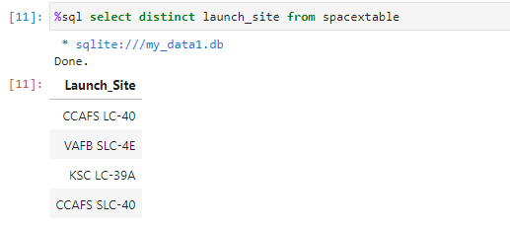
RESULTS All Launch Site Names
There are four unique Launch Sites used by SpaceX for Falcon 9 rocket

Slide 16
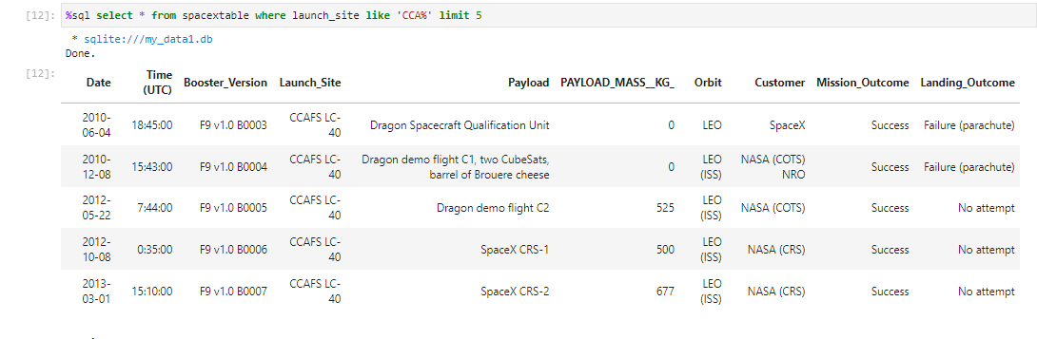
RESULTS Launch Sites Begin ‘CCA’
We found at least five launch sites begin with the string ‘CCA’

Slide 17
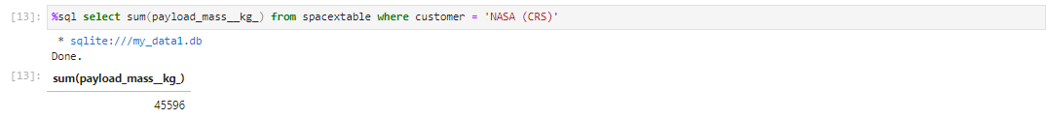
RESULTS Total Payload By NASA(CRS)
Total payload mass carried by boosters launched by NASA (CRS) is 45 596 kg

Slide 18
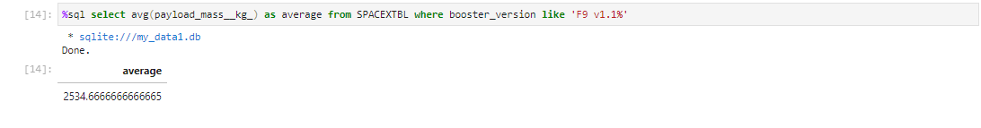
RESULTS Average Payload By F9 v1.1
Average payload mass carried by booster version F9 v1.1 is 2 534 kg

Slide 19
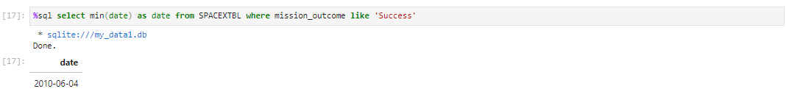
RESULTS First Successful Ground Landing Date
Date when the first succesful landing outcome in ground pad was achieved is
4th of June 2010

Slide 20
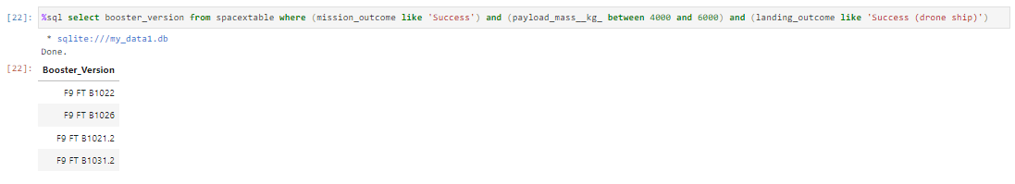
RESULTS Successful Drone Ship Landing
F9 FT booster versions have success in drone ship and have payload mass greater than 4000 but less than 6000 kg

Slide 21
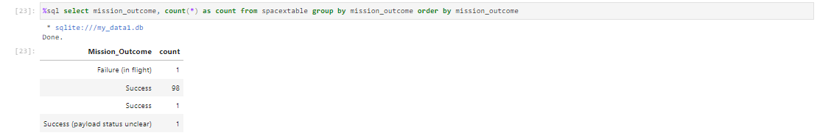
RESULTS Total Numbers Of Mission Outcomes
Successful mission outcome was 100 while failure just 1

Slide 22
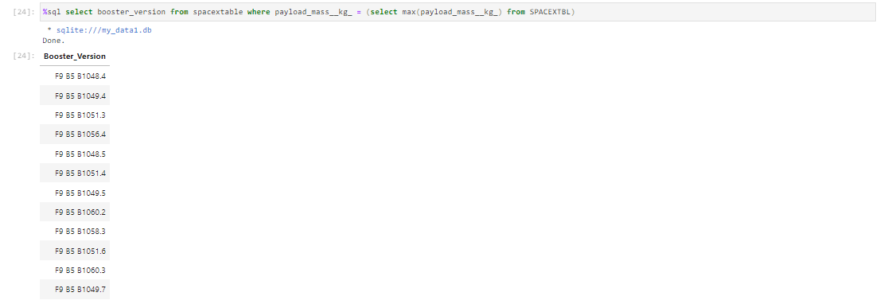
RESULTS Boosters Carried Maximum Payload Mass
F9 B5 booster versions have carried the maxium payload mass

Slide 23
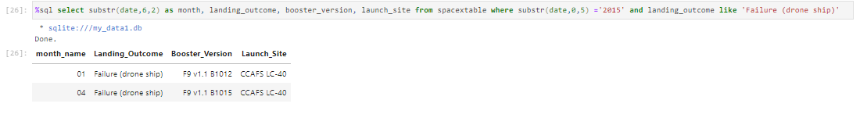
RESULTS 2015 Launch Sites
In 2015 failure landing_outcomes in drone ship was happened in January and April by F9 v1.1 booster in CCAFS LC 40 launch site

Slide 24
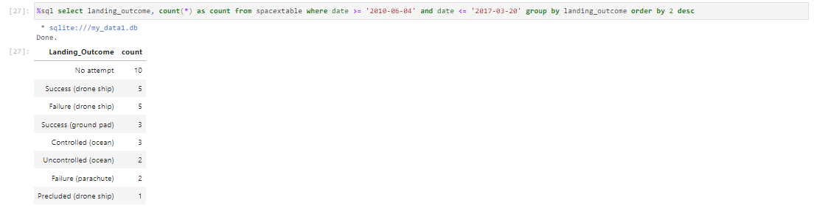
RESULTS Rank Landing 2010-06-04 and 2017-03-20
In selected period – the SpaceX had the same successful as failure landing outcomes in drone ship but the most not taken landings with total 10.

Slide 25
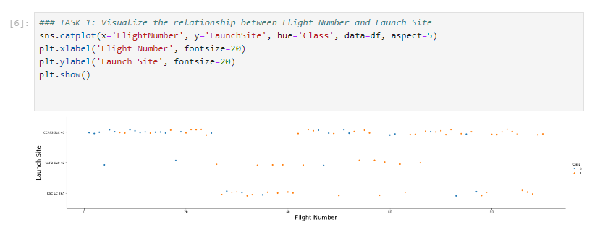
RESULTS Flight Number vs Launch Sites
The CCAFS SLC 40 has the highest flight number whilst VAFB SLC 40 has the fewest flight number

Slide 26
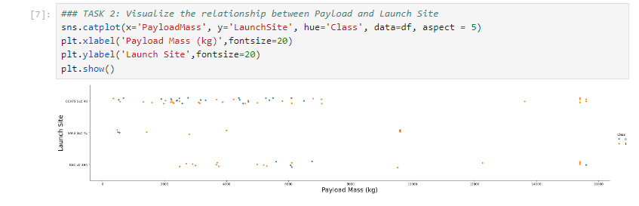
RESULTS Payload Mass vs Launch Sites
For every launch site higher payload mass, the higher success rate.
More of the launches with payload mass greater than 7 000 kg were successful.

Slide 27
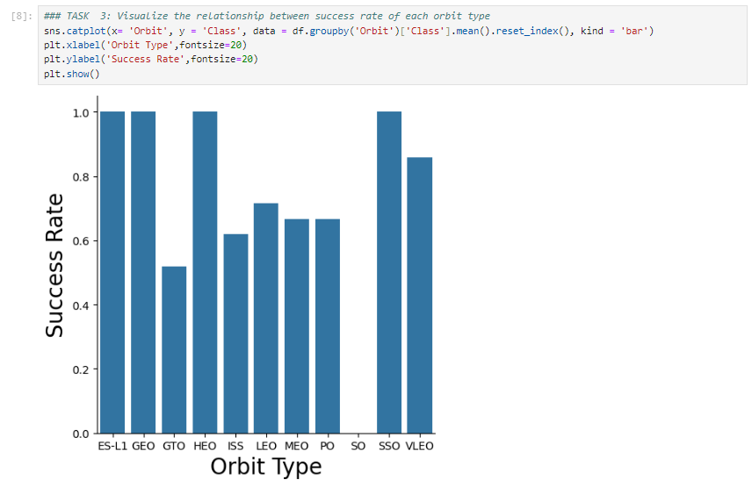
RESULTS Success Rate vs Orbit Type
There are four orbits with 100% success rate:
ES-L1
GEO
HEO
SSO
But only SO orbit is with
0% success rate

Slide 28
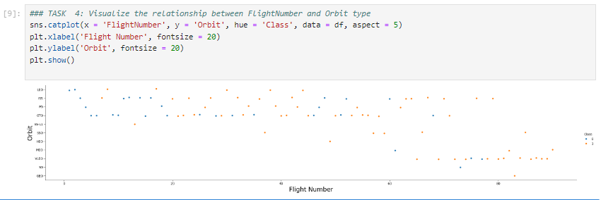
RESULTS Flight Number vs Orbit Type
Success rate have improved for mostly orbits where more flights were happened – especially for LEO and VLEO orbits whilst GEO orbit no relationship between success rate and flight number

Slide 29
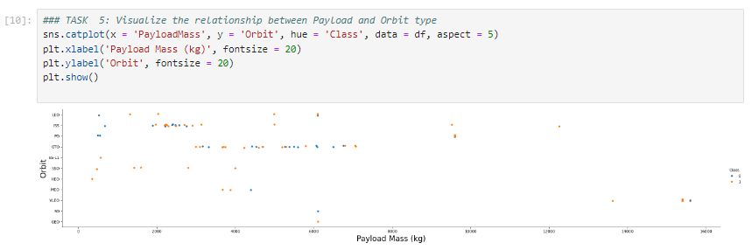
RESULTS Payload Mass vs Orbit Type
Success rate have improved for orbit LEO, ISS and PO with greater payload mass but negative impact on SSO and HEO orbits.

Slide 30
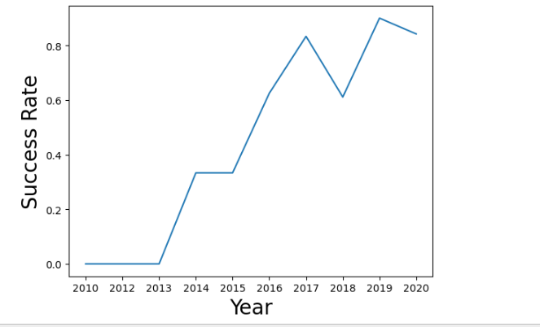
RESULTS Launch Sites Yearly Trend
The Launch Success Yearly Trend was positive over the years and increased from 2013 till 2020.

Slide 31
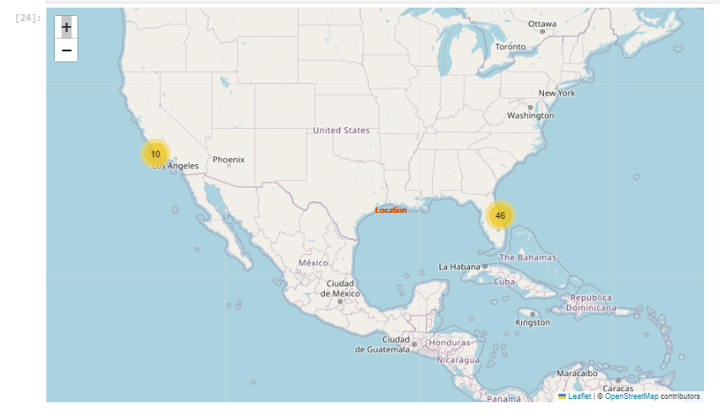
RESULTS SpaceX Launch Sites Locations
all sites locations are inside the United States
all sites are located near to coastline – west and east coast
all sites locations are in south located as possible as in equator line

Slide 32
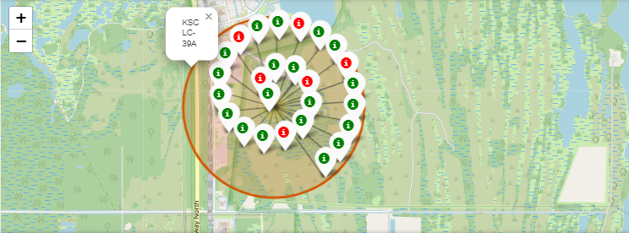
RESULTS Colour-labeled launch records on map
From the colour-labeled markers we should be able to easily identify which launch sites have relatively high success rates.
Green Marker = Successful Launch
Red Marker = Failed Launch
Launch Site KSC LC-39A has a very high Success Rate.

Slide 33
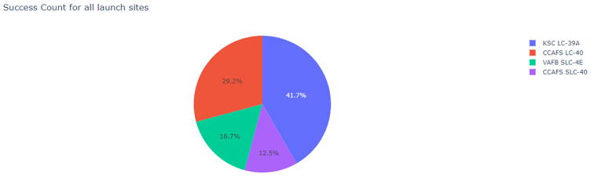
RESULTS % of Success By Each Launch Site
KSC LC-39A has the most successful launch with 41.7% from all successfull landings

Slide 34
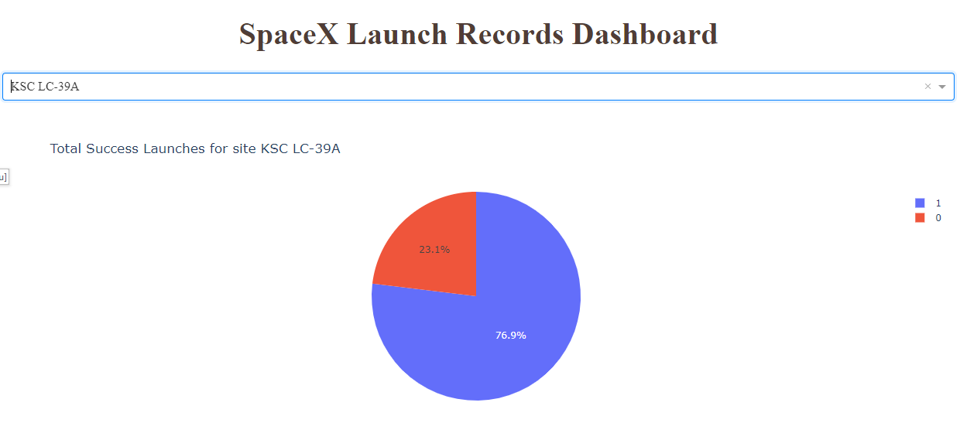
RESULTS The highest launch-success ratio
KSC LC-39A has 76.9% success rate while getting 23.1% failure rate

Slide 35
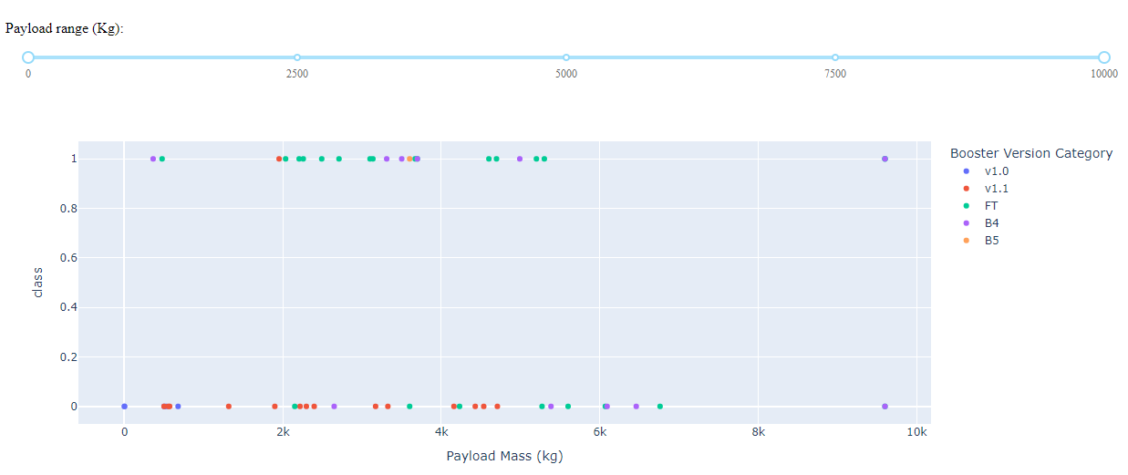
RESULTS Payload Mass vs Launch Outcome
The chart shows that the higest success rate is for playload mass between
2 000 kg and 5 500 kg for all site

Slide 36
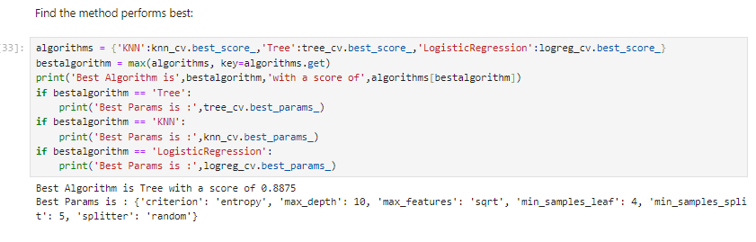
RESULTS Classification Accurancy
Decision Tree method is the best to predict successful landings with Accurancy 89%

Slide 37
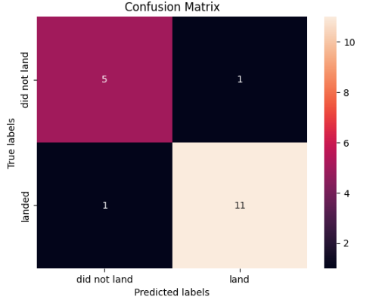
RESULTS Confusion Matrix
Examining the confusion matrix, we see that decision tree can distinguish between the different classes.
We see that the major problem is false positives i.e. unsuccessfull landing marked as successfull landing by clasifier.

Slide 38
CONCLUSION
Decision Tree Model is the best algorithm for this dataset.
Launches with a low payload mass show better results than launches with a larger payload mass.
Most of launch sites are in proximity to the Equator line and all the sites are in very close proximity to the coast.
The success rate of launches increases over the years.
KSC LC-39A has the highest success rate of the launches from all the sites.
Orbits ES-L1, GEO, HEO and SSO have 100% success rate.

Slide 39
APPENDIX
To get more details about Data Science
IBM Data Science
Jupyter notebooks and the presentation is available from
GitHub

Slide 40
THANK YOU

